Slide 1

BARRIER EXAMPLE
Explanations that deliver information to learners in extended blocks without pauses (in class)
Beth Stark, Educator and Consultant · Inclusive Learning Systems · UDL · Accessibility · © Beth Stark · CC BY-NC 4.0 · bethstark.org
1
Notes:
Routine 1 uses this slide on its own. Routines 2 and 3 use Slides 1, 2 and 3.

Slide 2
BARRIER CLUE EXAMPLES
You may observe learners who…
…find it challenging to stay engaged or lose focus during lengthy explanations, suggesting the design may not yet build in enough variation or pause.
…retain only the first or last point shared, possibly reflecting that they find it challenging to hold multiple pieces of information at once and the design provided no structured pause to consolidate.
…show visible disengagement within two to three minutes of uninterrupted verbal delivery, which may reflect that they find sustained focus challenging and the design builds in no variation.
…become disconnected from the content when it is only accessible through the language of instruction and the design offers no pause point or alternative entry.
Beth Stark, Educator and Consultant · Inclusive Learning Systems · UDL · Accessibility · © Beth Stark · CC BY-NC 4.0 · bethstark.org
2

Slide 3
POSSIBILITIES FOR REDUCING THE BARRIER THROUGH DESIGN
Segment instruction into shorter units and find ways to build a deliberate pause into each segment, treating consolidation as structural rather than optional.
Explore ways to offer multiple consolidation options during each pause, such as writing, talking to a partner, sketching, or sitting quietly, so that every learner can process in a way that works for them.
Create a visual or physical signal that marks the pause point, such as a projected timer, a verbal cue, or a physical gesture, so every learner knows the pause is coming and can prepare to use it.
Invite learners to use the pause in any language or form that works for them, making explicit that multilingual consolidation and non-verbal representation are valid and valued options in this design.
Use each pause point as an opportunity to reconnect every learner to the meaning and purpose of the learning goal, offering a brief written or spoken prompt that names where the current content sits within the larger picture of what is being learned and why.
Beth Stark, Educator and Consultant · Inclusive Learning Systems · UDL · Accessibility · © Beth Stark · CC BY-NC 4.0 · bethstark.org
3

Slide 4
LEVERAGING THE UDL GUIDELINES AS A DESIGN SCAFFOLD FOR REDUCING LEARNING BARRIERS
Barrier Example | Engagement | Representation | Action & Expression
Explanations that deliver information to learners in extended blocks without pauses (in class). | Design Options for Sustaining Effort & Persistence (8) Clarify the meaning and purpose of goals (8.1) Design Options for Emotional Capacity (9) Promote individual and collective reflection (9.3) | Design Options for Language & Symbols (2) Cultivate understanding and respect across languages and dialects (2.3) Design Options for Building Knowledge (3) Connect prior knowledge to new learning (3.1) | Design Options for Expression & Communication (5) Use multiple media for communication (5.1)
Read each consideration at udlguidelines.cast.org
Beth Stark, Educator and Consultant · Inclusive Learning Systems · UDL · Accessibility · © Beth Stark · CC BY-NC 4.0 · bethstark.org
4
Notes:
Show this slide after any routine to connect the conversation to the UDL Guidelines and Considerations.

Slide 5
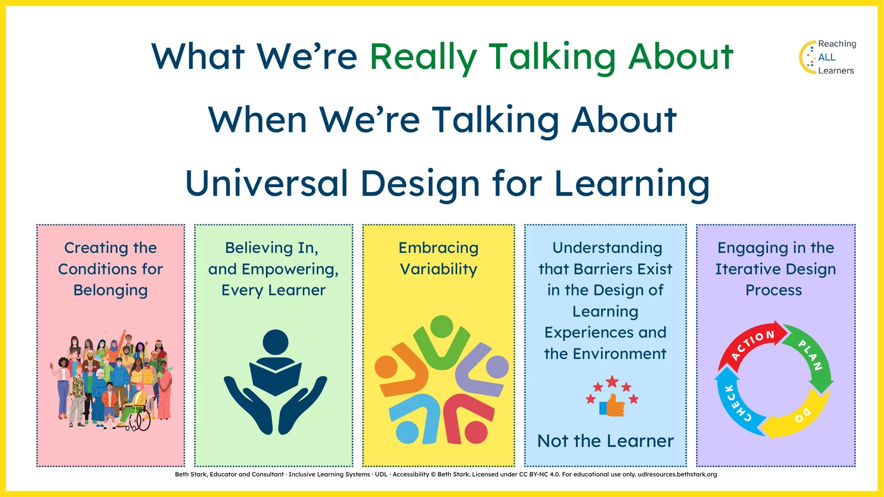
WHAT WE’RE REALLY TALKING ABOUT WHEN WE’RE TALKING ABOUT UDL
Beth Stark, Educator and Consultant · Inclusive Learning Systems · UDL · Accessibility · © Beth Stark · CC BY-NC 4.0 · bethstark.org
5

